Slide 1

WELCOME

Slide 2

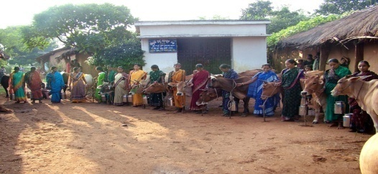
ORGANISATIONAL DYNAMICS
FEDERATION
(PLANNING, MONITORING,
PROCESSING & MARKETING)
UNION
(MILK PROCUREMENT &
INPUT SERVICES)
DAIRY COOPERATIVE
SOCIETY
(PROCUREMENT & INPUT SERVICES
AT VILLAGE LEVEL)
MEMBER
(REAR COWS & PRODUCE MILK
FOR SOCIO-ECONOMIC UPLIFTMENT)

Slide 3
VISION OF OMFED
To be a leading milk producing Organisation at International level of efficiency with widest and satisfied customer base maximising wealth of Stake holders and contributing to the State economy.

Slide 4
District level / Regional level state Cooperative Milk Union
(Central level cooperative society)
Cuttack Milk Union
Puri Milk Union
Sambalpur Milk Union
Balasore Bhadrak Milk Union
Greater Ganjam Gajapati Milk Union
Koraput Malkanagiri Nawarangpur Rayagada Milk Union
Bolangir Kalahandi Nuapada Milk Union
Keonjhar Milk Union
Dhenkanal Milk Union
Mayurbhanj Milk Union
Boudh Kandhamal Milk Union
Sundargarh Milk Union

Slide 5
Milk Producer Cooperative Society
(Primary level cooperative society)
Organised Society : 5281
Functional Society : 3644
Registered Society : 2451
Farmer Families involved : 272257

Slide 6
INFRASTRUCTURES
Sl No. | PARTICULARS | NO | CAPACITY
01 | DAIRY PLANTS | 11 | 5.45 LAKH LTR/DAY
02 | MILK CHILLING CENTERS | 11 | 2,02,000 LTR/ DAY
03 | BULK COOLER | 322 | 4.38 LAKH LTR/DAY
04 | MILK POWDER PLANT | 1 | 5 MT PER DAY
05 | CATTLE FEED PLANT | 1 | 200 MT / DAY
06 | FRUIT PROCESSING UNIT | 1 | SAMANTARAPUR
07 | TRAINING CENTRE | 3 | JAGANNATHPUR, PURI NADHANA, PURI GOSHALA, SAMBALPUR
08 | STATE LABORATORY | 1 | CHANDRASEKHARPUR BHUBANESWAR DAIRY
09 | ICE CREAM PLANT | 1 | 5000 LTR / DAY

Slide 8
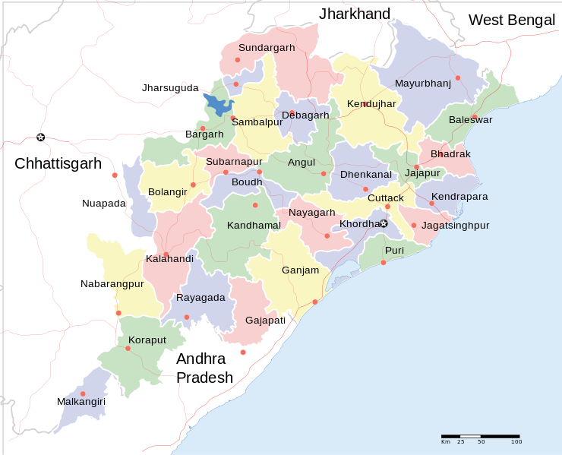

→
→
→
→
→
→
→
→
→
→
→
→ DAIRY PLANT

Slide 9



◉

 CATTLE FEED PLANT
 TRAINING CENTRE
◉ OMPAC

Slide 10
Achievement in 2013-14
Sl. No. | Particulars | Unit | Achievement
1 | No of Milk Unions | No. | 12
2 | Organised Society | No. | 5281
3 | Farmer Members | No. | 272257
4 | Milk Procurement | Kg/Day | 390257
5 | Milk Marketing | Ltr./Day | 432239
6 | AI centre | No. | 1190
7 | AI done | No. | 296892
….continued

Slide 11
Achievement in 2013-14
Sl. No. | Particulars | Unit | Achievement
8 | Ghee Sale | Kg. | 636452
9 | SFM Sale | Bottle | 1981914
10 | Sweet curd sale | Kg. | 588353
11 | Butter Sale | Kg. | 6508
12 | Plain Curd Sale | Kg. | 8200446
13 | Butter Milk | Packet | 4553059
14 | Paneer | Kg. | 525914
15 | Chhenapoda | Kg. | 17990
16 | Lassi | Packet | 2673983
17 | Ice Cream | Ltr. | 642261

Slide 12
MILK PROCUREMENT/MARKETING SINCE 2001 TO 2014
(IN ‘000 KPD)
PROC.
MKTG.
YEAR
Notes:
12
12

Slide 17
DCS ORGANISED/ MEMBERSHIP
(APRIL – MARCH)
256751
272257
244295
253343
236199
246410
224002
204013
167802
Notes:
BLUE - SOCIETY
GREEN- MEMBERSHIP

Slide 20
CATTLEFEED PRODUCTION & SALE (IN MT)
IN ‘000 MTS
SALE
Notes:
20

Slide 23
TURN OVER
(Rs. in lakhs)
X 1000
YEAR
Notes:
23
23

Slide 24
NET PROFIT
(Rs. in lakhs)
YEAR
Notes:
24
24

Slide 25

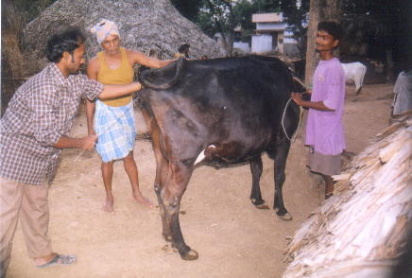
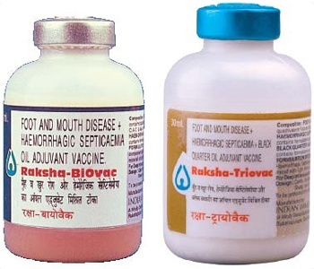
BENEFIT GIVEN TO MEMBERS OF DAIRY COOPS.
FACILITY TO DISPOSE MARKETABLE SURPLUS MILK THROUGH MPCS AT DOORSTEP ROUND THE YEAR
MILK VALUE PAYMENT REGULARLY AT 10 DAYS INTERVAL
SUPPLY OF INPUTS AT MPCS LEVEL AT SUBSIDISED RATE
  QUALITY CATTLE FEED
  MINERAL MIXTURE/ CALCIUM ETC.
  ARTIFICIAL INSEMINATION FACILITY
  CATTLE HEALTH MEDICINES
  VACCINES
  ANIMAL HEALTH CAMPS
  DEWORMING MEDICINES
  FODDER SEEDS
  TRAINING
  LEAFLETS

Slide 26
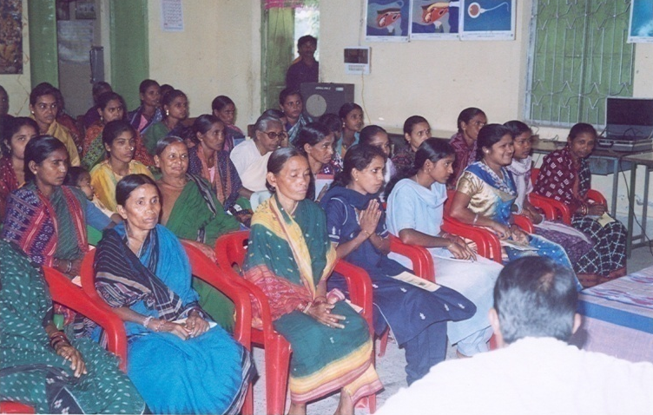
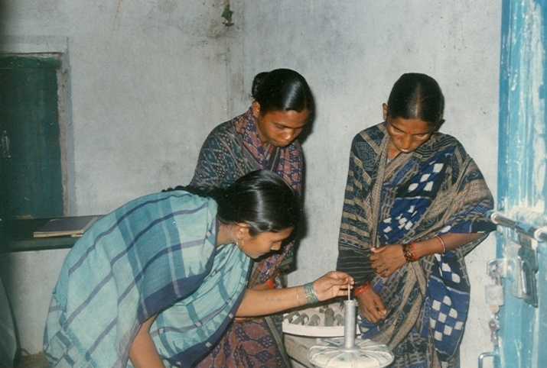
BENEFIT GIVEN TO MEMBERS OF DAIRY COOPS.
TRAINING & ORIENTATION
  DAIRY ANIMAL MANAGEMENT FOR SKILL DEVELOPMENT
  SOCIETY MANAGEMENT
  MANAGEMENT COMMITTEE TRAINING
  MILK TESTING
  CATTLE FIRST-AID TRAINING
  FIELD VISIT TO OTHER MILKSHED AREAS
  SOCIAL SECURITY PROGRAMME

Slide 27
BENEFIT TO VILLAGE LEVEL
DAIRY COOPERATIVE
MILK TESTING EQUIPMENTS
ELECTRONIC MILKO TESTER
MILK CANS
FURNITURE
MILK TESTING CHEMICALS
STATIONERIES
LIQUID NITROGEN, FROZEN SEMEN
FIRST-AID MEDICINE/FACILITIES
AUTOMATIC MILK COLLECTION STATIONS
BULK MILK COOLERS

Slide 28

THANK YOU

